Slide 1
Applied data science

Slide 2
Customer segmentation using data science
Problem statement
Design thinking process
Phases of development
Dataset used
Data preprocessing steps
Feature extraction techniques
Machine learning algorithm
Model training
Evalution steps
conclusion

Slide 3
PROBLEM STATEMENT
The problem is to effectively group customers into segments based on their shared characteristics, preferences, and behaviors. This segmentation is crucial for businesses looking to:
Understand their customer base better.
Target specific customer segments with personalized marketing campaigns.
Optimize product or service offerings for different segments.
Improve customer retention and acquisition strategies.
Make data-driven decisions for business growth.

Slide 4
DESIGN THINKING PROCESS
Design thinking is a human-centered, iterative problem-solving approach. Here's how it can be applied to customer segmentation using data science:
Empathize: Understand your customers by gathering data and conducting research. Identify their needs, behaviors, and pain points. This involves collecting both qualitative and quantitative data.
Define: Clearly define the problem you want to solve through customer segmentation. This might involve defining the characteristics or attributes that will be used for segmentation.

Slide 5
Ideate: Generate ideas for customer segmentation strategies. Brainstorm potential variables or features that can be used to segment customers. Consider different data sources, such as demographic, psychographic, and transactional data.
Prototype: Create initial customer segments based on your ideas. This can be done manually or with the help of data science tools and algorithms. Develop a prototype segmentation model.
Test: Evaluate the prototype segmentation model using historical data or a subset of your customer base. Measure the model's performance and assess how well it identifies distinct customer segments.

Slide 6
Feedback and Refine: Gather feedback from stakeholders and data experts. Refine the segmentation model based on the feedback, and iterate as necessary.
Implement: Deploy the final segmentation model on your complete customer dataset. Make it an integral part of your decision-making process.
Iterate: Continuously monitor the effectiveness of the segmentation model and refine it over time as new data becomes available or customer behaviors change.

Slide 7
Phases of Development for Customer Segmentation
The development of customer segmentation using data science can be broken down into several phases:
Data Collection: Collect and aggregate relevant data from various sources, such as customer databases, CRM systems, social media, surveys, and website analytics.
Data Preprocessing: Clean, transform, and prepare the data for analysis. This may involve handling missing values, standardizing data, and feature engineering.
Exploratory Data Analysis (EDA): Conduct EDA to gain insights into the data and identify potential variables for segmentation. Visualize and summarize the data to understand customer behavior.

Slide 8
Feature Selection: Choose the most relevant features or variables for segmentation. Feature selection can help improve the accuracy of the segmentation model.
Model Selection: Choose an appropriate data science algorithm or method for customer segmentation. Common approaches include clustering techniques like k-means, hierarchical clustering, or machine learning models like decision trees, random forests, or neural networks.
Model Training: Train the chosen model on the prepared data, using a portion of the data for training and another portion for testing and validation.
Validation and Evaluation: Evaluate the segmentation model's performance using appropriate metrics, such as silhouette score, Davies-Bouldin index, or domain-specific measures. Ensure that the model effectively identifies distinct customer segments.

Slide 9
Interpretation: Interpret the segments and gain actionable insights. Understand the characteristics and behaviors of each segment and their implications for marketing and product strategies.
Deployment: Implement the segmentation model in your business processes to guide decision-making, marketing campaigns, and product development.
Monitoring and Maintenance: Continuously monitor the segments and update the model as needed to adapt to changing customer behaviors and market dynamics.
By following this outline, businesses can use data science to effectively segment their customers, leading to more targeted and personalized strategies that enhance customer satisfaction and drive business growth.

Slide 10
Dataset Description
The dataset used for customer segmentation typically contains information about individual customers or clients.
Common features in the dataset include customer demographics (age, gender, location), transaction history, purchase behavior, online activity, customer support interactions, and more.
The dataset can be collected from various sources, such as CRM databases, e-commerce platforms, social media, surveys, and so on.

Slide 11
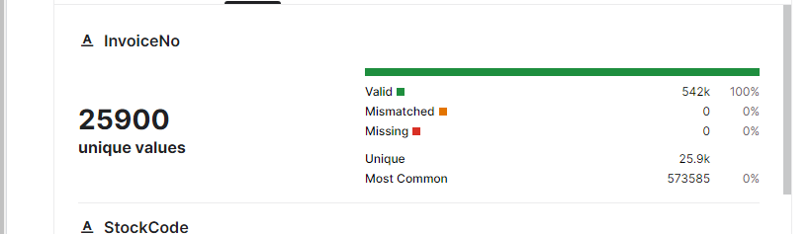
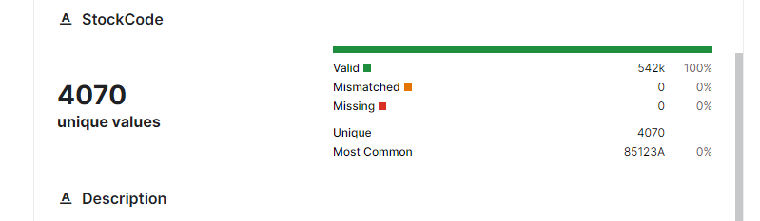
DATASET

Slide 12
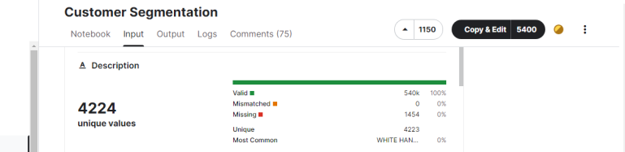
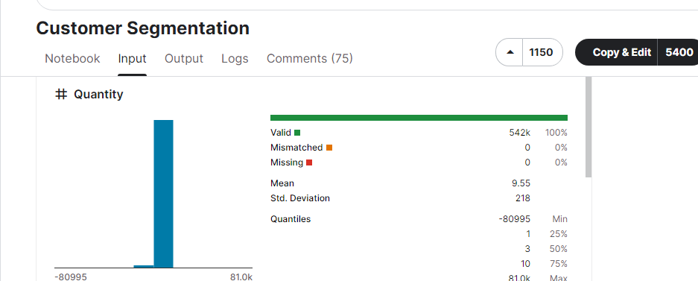

Slide 13
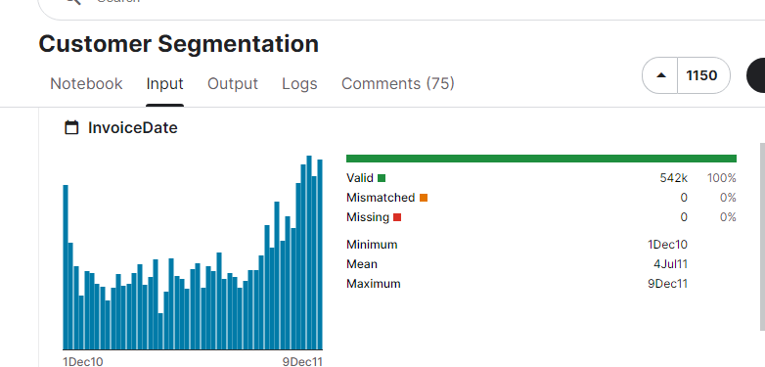
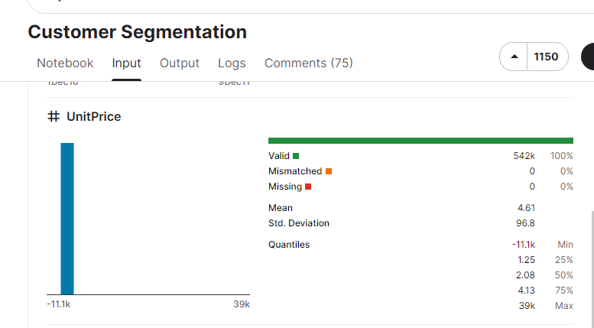

Slide 14
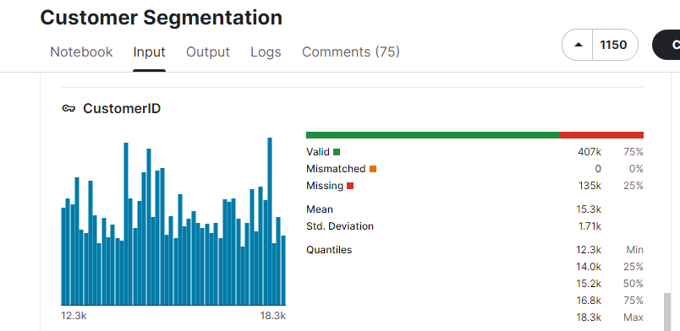
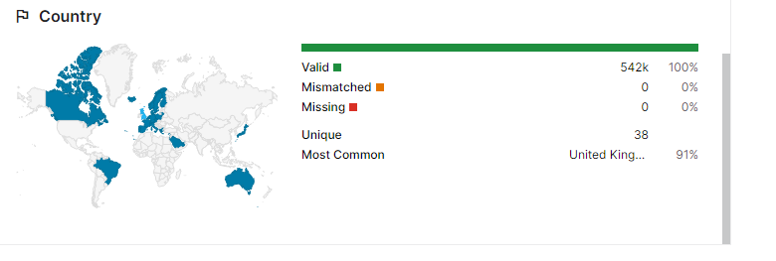

Slide 15
Data Preprocessing
Data preprocessing is a crucial step to clean and prepare the dataset for analysis:
Data Cleaning: This involves handling missing values, outliers, and noise. Missing data can be imputed using mean, median, or mode values, while outliers may be detected and dealt with using statistical methods or domain knowledge.
Data Transformation: Transformation techniques may include scaling numerical features (e.g., using Min-Max scaling or Standardization) and encoding categorical variables (e.g., one-hot encoding or label encoding).

Slide 16
Feature Engineering: Creating new features or modifying existing ones can provide valuable information for segmentation. For example, you can calculate metrics such as customer recency, frequency, and monetary value (RFM) based on transaction history.
Dimensionality Reduction: Techniques like Principal Component Analysis (PCA) or feature selection methods can be used to reduce the dimensionality of the dataset and remove less informative features.
Normalization: Depending on the algorithm used for segmentation, it may be necessary to normalize the data to ensure that features have the same scale.

Slide 17
Feature Extraction
Feature extraction is the process of deriving relevant features from the dataset for segmentation:
RFM Features: Recency, Frequency, and Monetary Value are commonly used features in customer segmentation. These features quantify how recently a customer made a purchase, how often they make purchases, and how much they spend.
Behavioral Features: These features describe customer behavior, such as the average time spent on the website, the number of products viewed, and the interaction with promotional emails or offers.
Demographic Features: Features like age, gender, location, and income can be important for segmentation, especially for businesses with products or services that target specific demographics.

Slide 18
Modeling and Segmentation
After data preprocessing and feature extraction, you can apply various segmentation techniques, including:
K-Means Clustering: A popular unsupervised clustering algorithm that groups customers based on similarities in their feature values.
Hierarchical Clustering: Divides customers into a hierarchy of clusters, which can be useful for exploring different levels of granularity.
DBSCAN: Density-based spatial clustering of applications with noise is effective at identifying clusters of arbitrary shapes and handling noise.
Machine Learning and Classification: You can also use supervised classification models (e.g., decision trees, random forests, or support vector machines) to predict customer segments based on their features.

Slide 19
Choice of Machine Learning Algorithm
Unsupervised Learning: Customer segmentation is typically done using unsupervised learning techniques, such as clustering algorithms. Common choices include:K-Means Clustering: It's simple and efficient. It partitions the data into K clusters based on feature similarity.
Hierarchical Clustering: It creates a tree-like structure of clusters.
DBSCAN (Density-Based Spatial Clustering of Applications with Noise): It's useful for discovering clusters with varying shapes and densities.
Gaussian Mixture Model (GMM): It assumes that the data is generated from a mixture of Gaussian distributions.

Slide 20
Model Training
Choose the appropriate algorithm based on the nature of your data and problem.
Determine the number of clusters (K) in advance or use techniques like the elbow method, silhouette score, or dendrogram analysis to find the optimal number of clusters.
Train the model using the prepared data.

Slide 21
Evaluation Metrics
The choice of evaluation metrics depends on the clustering algorithm and your specific goals:Silhouette Score: Measures how similar each data point in one cluster is to other data points in the same cluster compared to other clusters. Values range from -1 to 1, with higher values indicating better separation.
Davies-Bouldin Index: Measures the average similarity between each cluster and its most similar cluster. Lower values are better.
Inertia (or Within-Cluster Sum of Squares): Measures the sum of squared distances of data points to their nearest cluster center. Lower inertia is better, but it tends to decrease as the number of clusters increases.
Calinski-Harabasz Index: Measures the ratio of between-cluster variance to within-cluster variance. Higher values are better.

Slide 22
Interpretation and Application
Once the model is trained and evaluated, interpret the clusters. What characteristics define each segment? Are there clear differences in customer behavior or demographics among the segments?
Apply the customer segments to your business strategy. Tailor marketing campaigns, product offerings, and customer service to the specific needs and preferences of each segment.

Slide 23
Iterate and Refine
Customer segmentation is not a one-time task. As your business evolves and collects more data, revisit and refine your segmentation models to adapt to changing customer behavior and preferences.

Slide 24
conclusion
Customer segmentation using data science is a crucial strategy for businesses to better understand their customer base. By analyzing data, such as demographics, behavior, and purchase history, businesses can group customers into distinct segments. This enables personalized marketing, product recommendations, and improved customer experiences. Ultimately, customer segmentation through data science empowers companies to maximize their marketing efforts, increase customer satisfaction, and drive overall business success.

Slide 25
CODING
# Import necessary libraries
import pandas as pd
import numpy as np
import matplotlib.pyplot as plt
from sklearn.cluster import KMeans
from sklearn.preprocessing import StandardScaler
from sklearn.decomposition import PCA
# Load your customer data (replace 'data.csv' with your dataset)
data = pd.read_csv('data.csv')
# Select relevant features for segmentation (e.g., purchase history, demographics, etc.)
features = data[['Feature1', 'Feature2', 'Feature3']]
# Standardize the features (mean=0, std=1)
scaler = StandardScaler()
scaled_data = scaler.fit_transform(features)

Slide 26
# Determine the optimal number of clusters using the Elbow Method
wcss = []
for i in range(1, 11):
kmeans = KMeans(n_clusters=i, init='k-means++', max_iter=300,
n_init=10, random_state=0)
kmeans.fit(scaled_data)
wcss.append(kmeans.inertia_)
# Plot the Elbow Method results to help choose the number of clusters
plt.plot(range(1, 11), wcss)
plt.title('Elbow Method')
plt.xlabel('Number of clusters')
plt.ylabel('WCSS') # Within-Cluster Sum of Squares
plt.show()
# Based on the Elbow Method, choose the optimal number of clusters
optimal_clusters = 3 # Adjust this based on the plot

Slide 27
# Apply K-Means clustering with the chosen number of clusters kmeans = KMeans(n_clusters=optimal_clusters, init='k-means++', max_iter=300, n_init=10, random_state=0) clustered_data = kmeans.fit(scaled_data) # Add cluster labels to your original dataset data['Cluster'] = kmeans.labels_ # Visualize the clusters using PCA for dimensionality reduction (2D visualization) pca = PCA(n_components=2) reduced_data = pca.fit_transform(scaled_data) reduced_df = pd.DataFrame(data=reduced_data, columns=['PC1', 'PC2']) reduced_df['Cluster'] = kmeans.labels_ # Plot the clusters in 2D space plt.scatter(reduced_df['PC1'], reduced_df['PC2'], c=reduced_df['Cluster'], cmap='viridis') plt.title('Customer Segmentation') plt.show() # Analyze the results, and further tailor your marketing strategies or other actions for each cluster

Slide 28
THANK YOU

